Slide 1
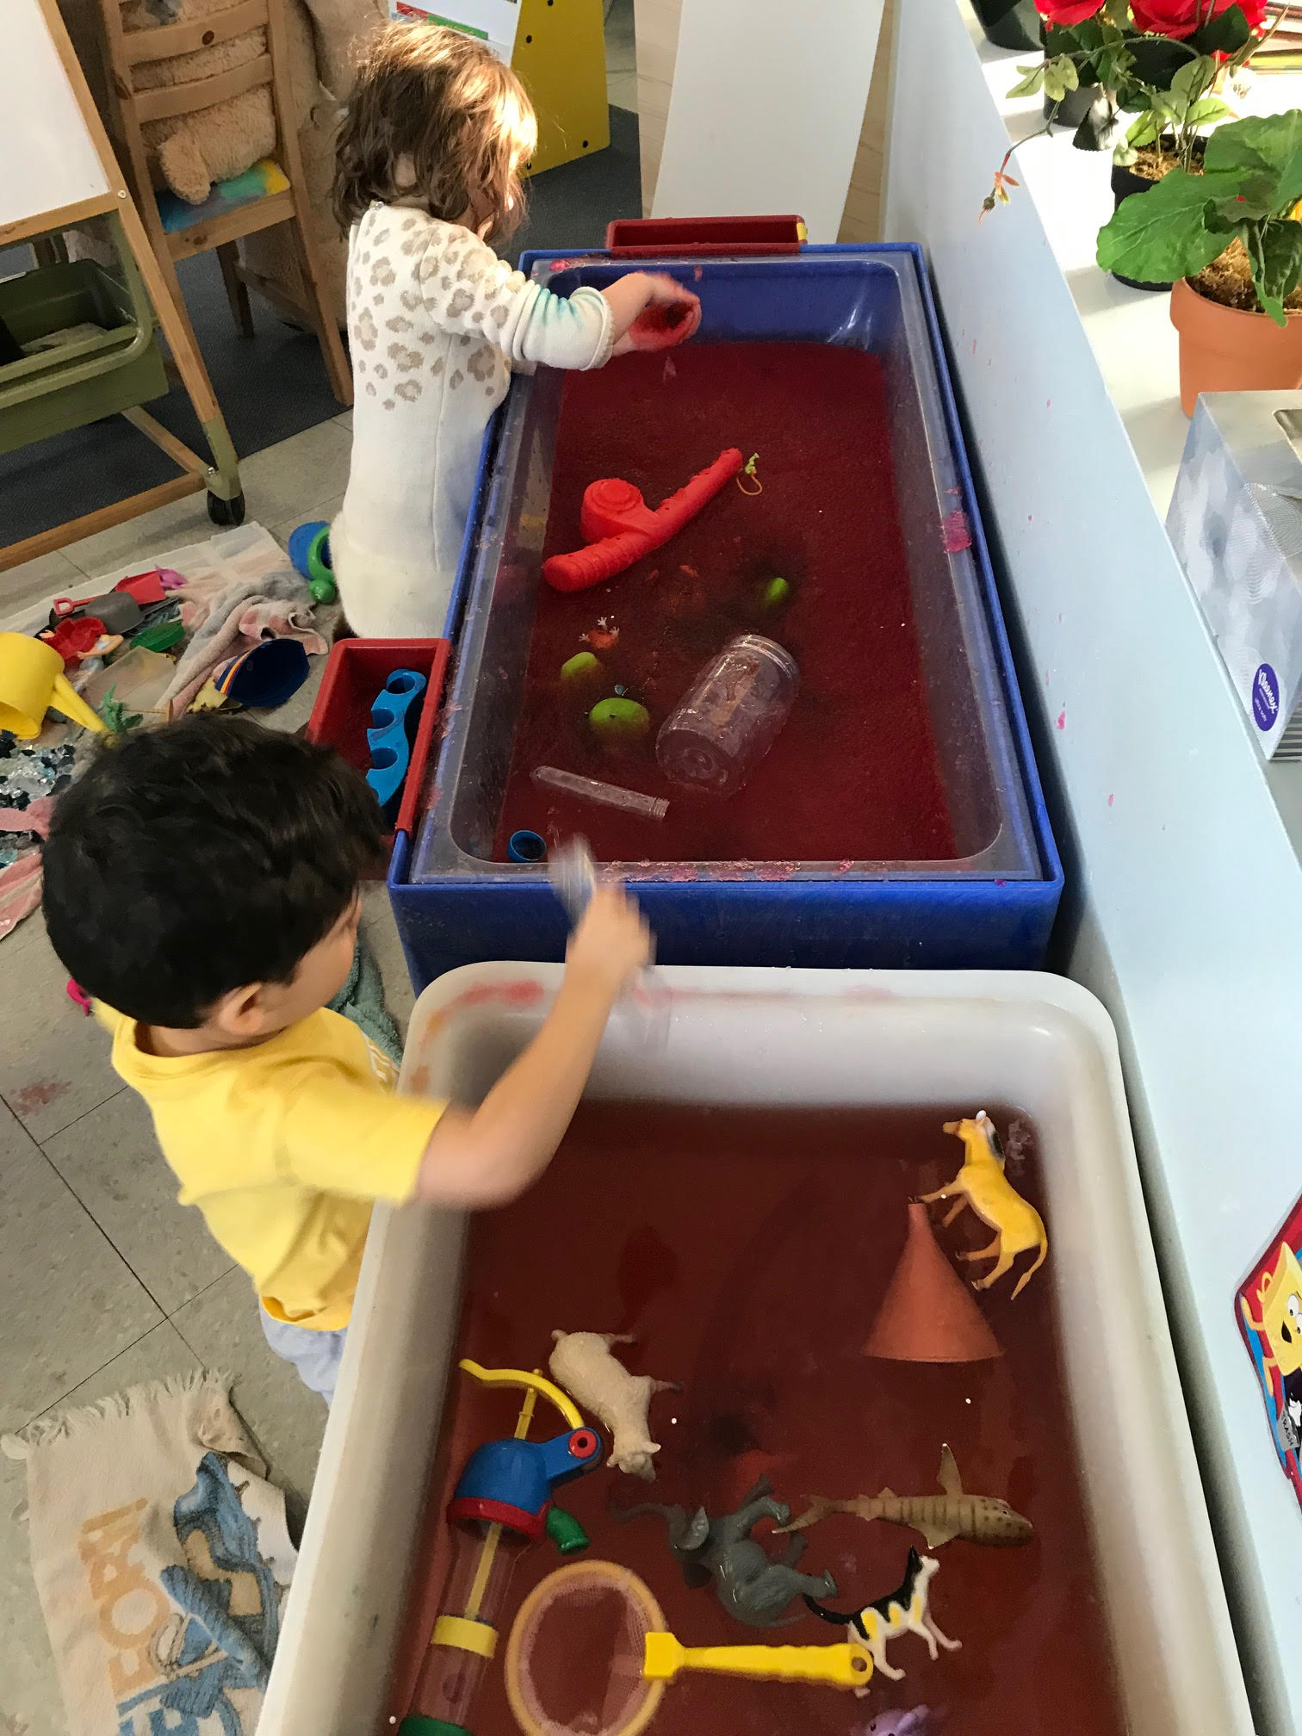
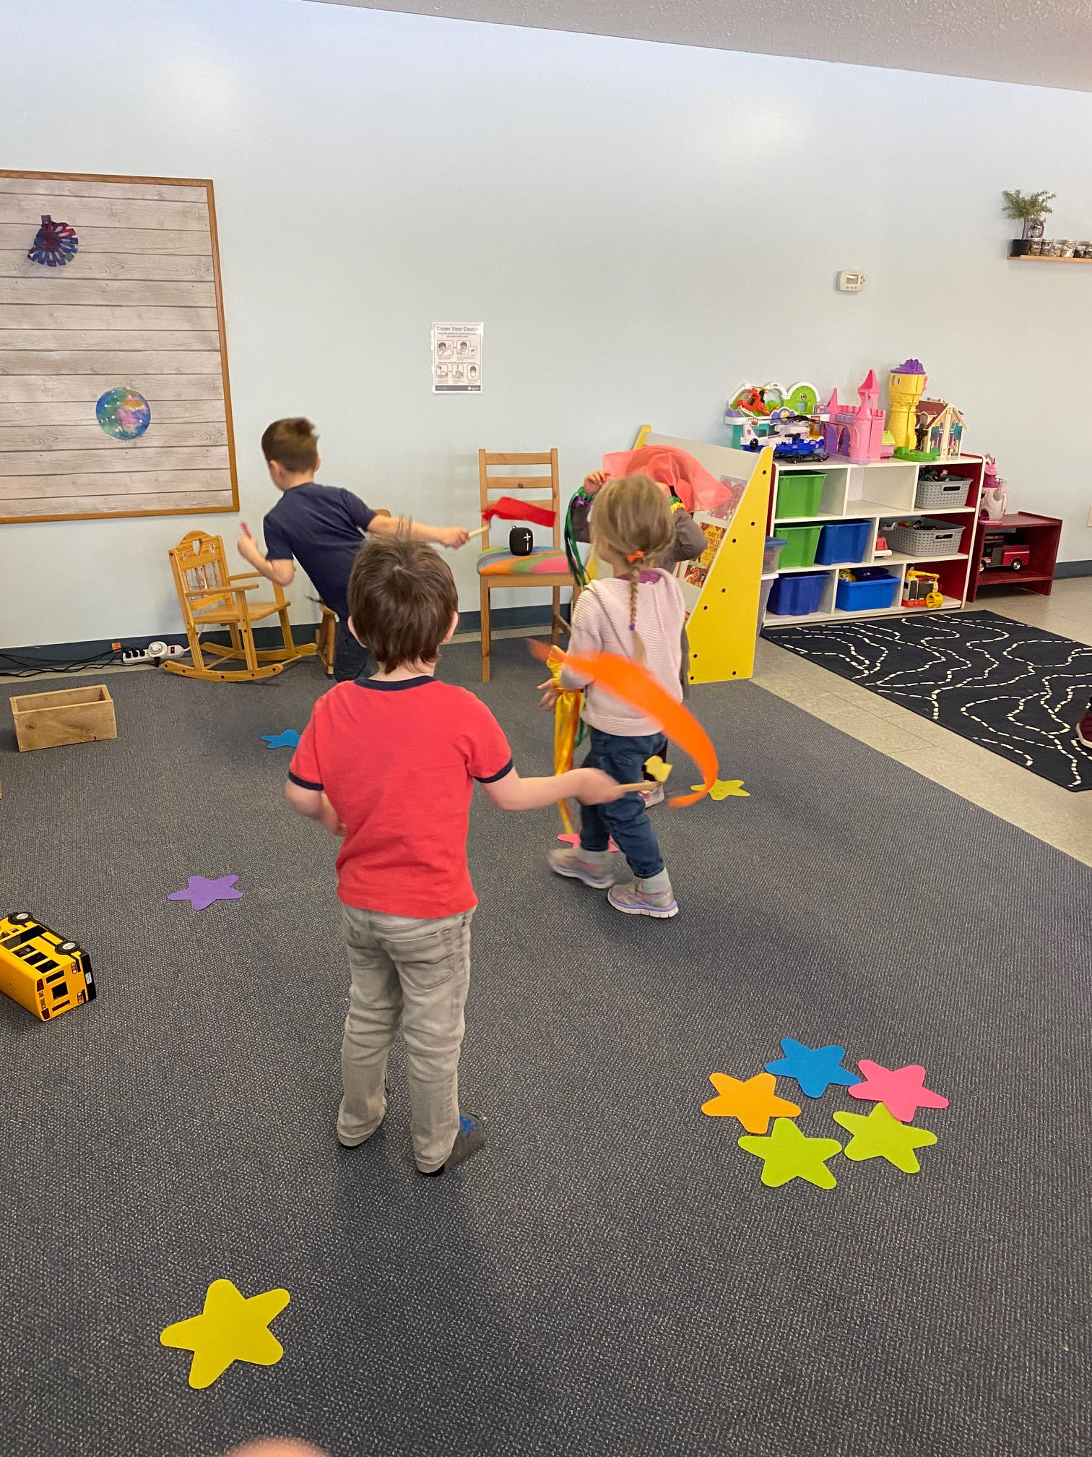
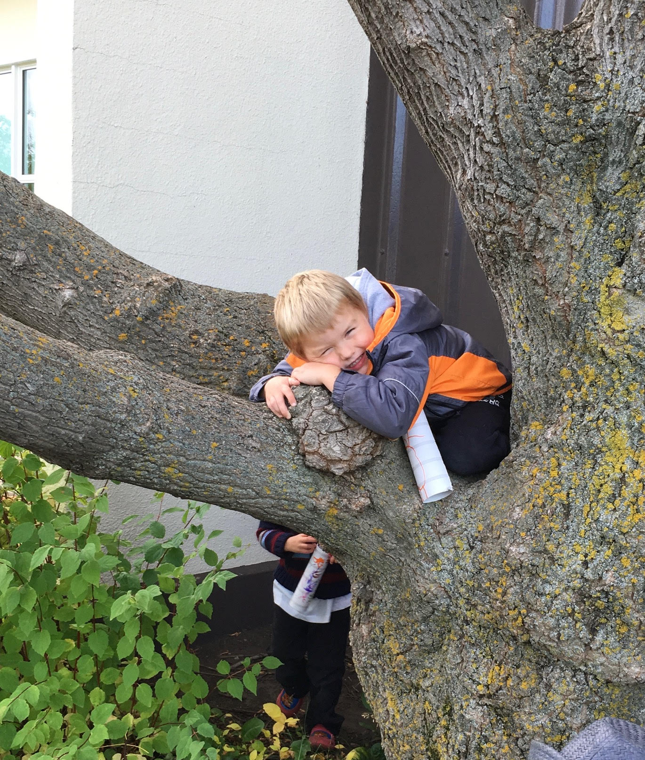
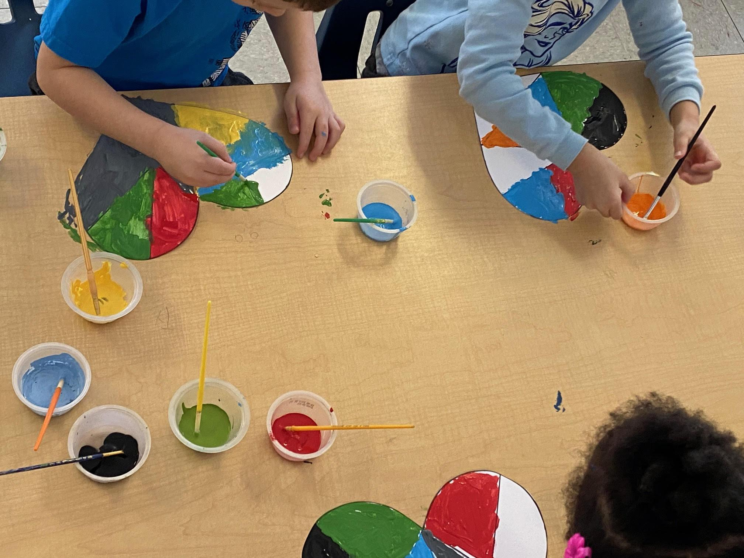
Avonmore Community Playschool
Online Open House
March 2021

Slide 2
Welcome Parents!
Welcome parents to our online open house.
The goals of the open house are:
To help parents understand the work their child will be doing throughout the school year.
To explain expectations of their child.
To share information about how parents can support their child’s learning.
Parents to see the learning environment

Slide 3
Our Philosophy
Our teachers create a fun and exciting “learning through play” program in a caring and nurturing environment. Our program supports children’s social, emotional, cognitive and physical growth by providing a wide variety of stimulating and developmentally appropriate experiences.

Slide 4
Our Philosophy
We believe in a play based learning approach. What we mean by this is half of the day is child directed and the other part of the day is teacher directed. Having a place that offers the children the right to make their own choices is very important in helping children learn the skills they will need to have to a positive self esteem. The class and the teachers share the decision-making. For example when is snack? We aim to have snack every day starting at 10:00am. Sometimes by 9:45 all the kids are ready to eat or finally by 10:20 they are hungry. This is a choice we make together. When it comes to group activities the children are more willing to participate because they had their undirected play time and are given choices

Slide 5
Our Philosophy
The benefits of undirected play are:
Learning to play and cooperate with others
Learn to share space and items
Begin to recognize others feelings
Become better at negotiation
Learn new problem solving skills
They begin to solve their own problems without adult interference
Learn by playing out feeling they may have to make sense of them
Confidence
Discover more about what they like (choices)
Create new friendships

Slide 6
Our Philosophy
Here at Avonmore Community Playschool we provide children with a wide variety of experiences and allow the children to develop at their own speed, while assisting them in their everyday learning. We understand the importance of play and how it is essential to growing minds. We dedicate special time to project based learning, while directing our planning of activities on the children’s interests, creating a more engaging environment for the children to learn and grow! And yes, lots of play!

Slide 7
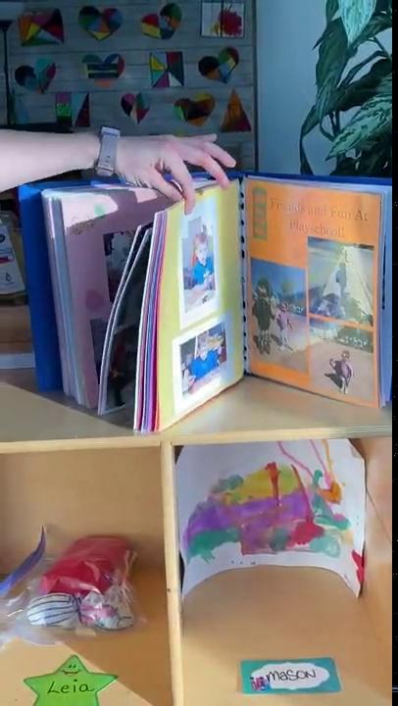
Our Teacher and our Space
A tour of our classroom space

Slide 8
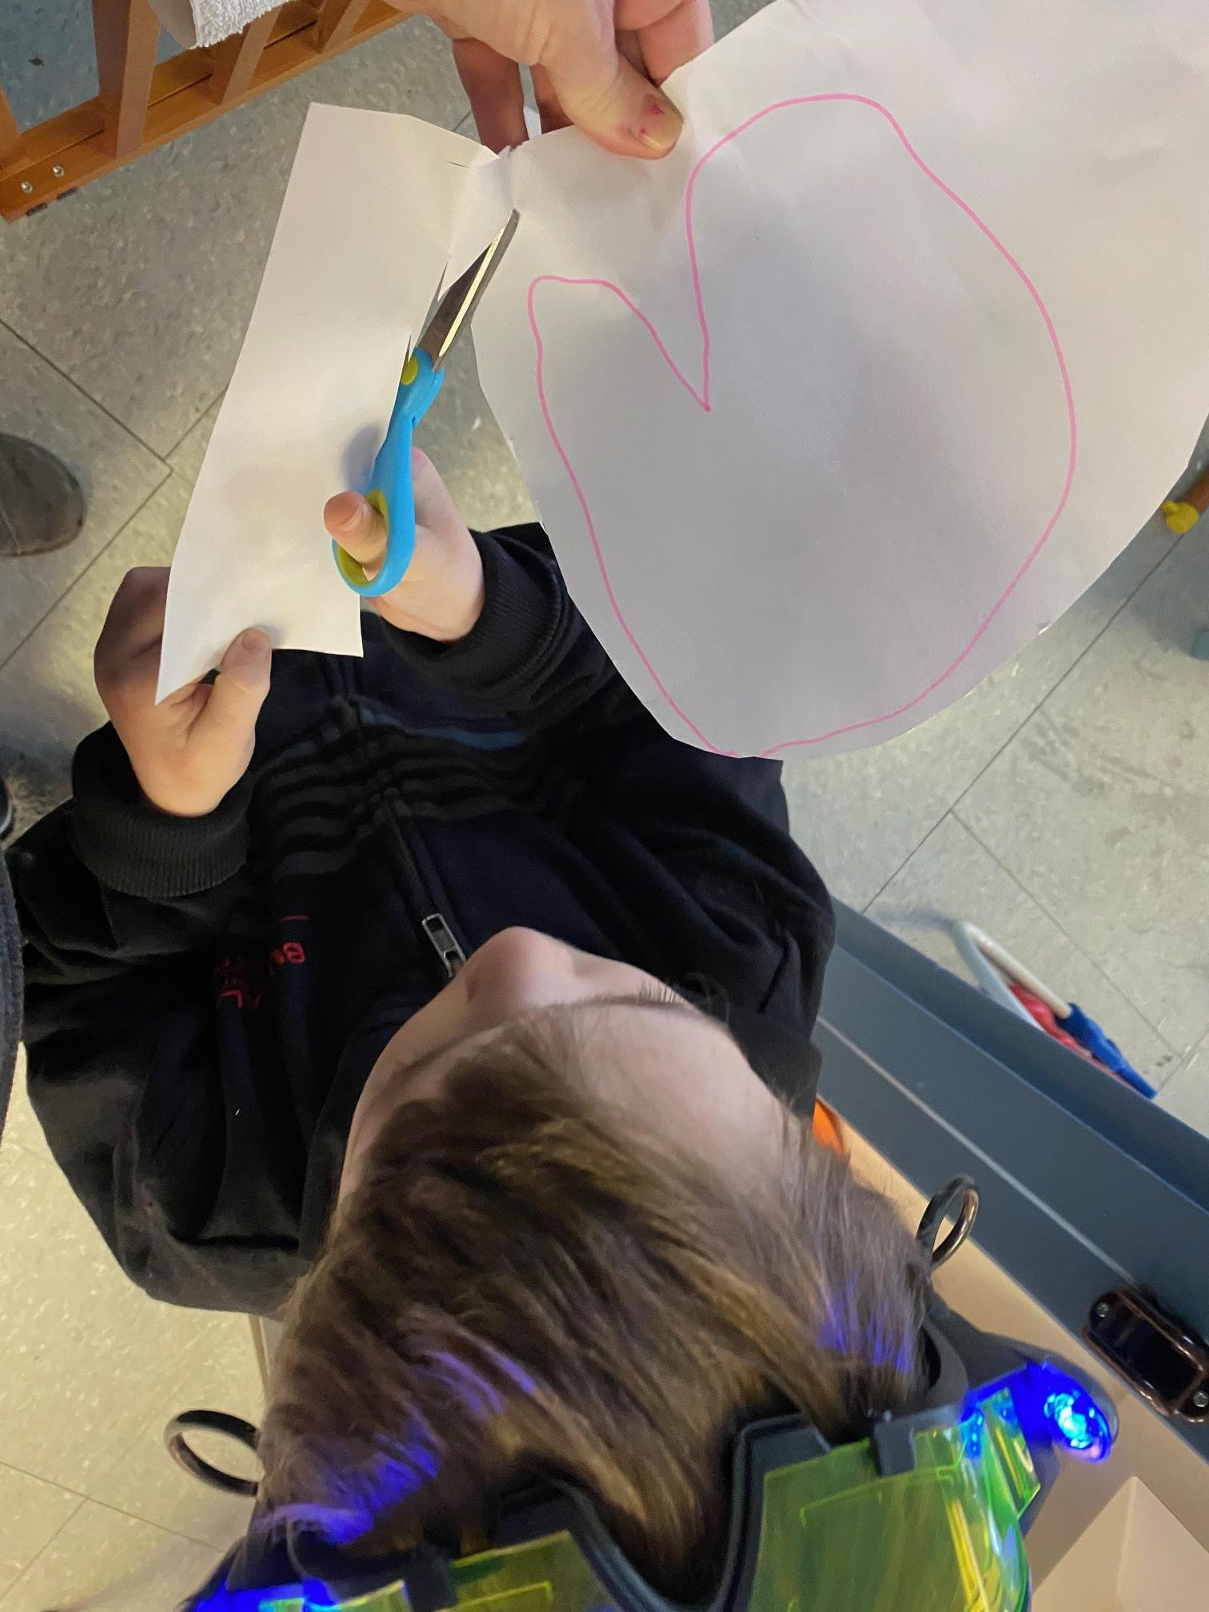
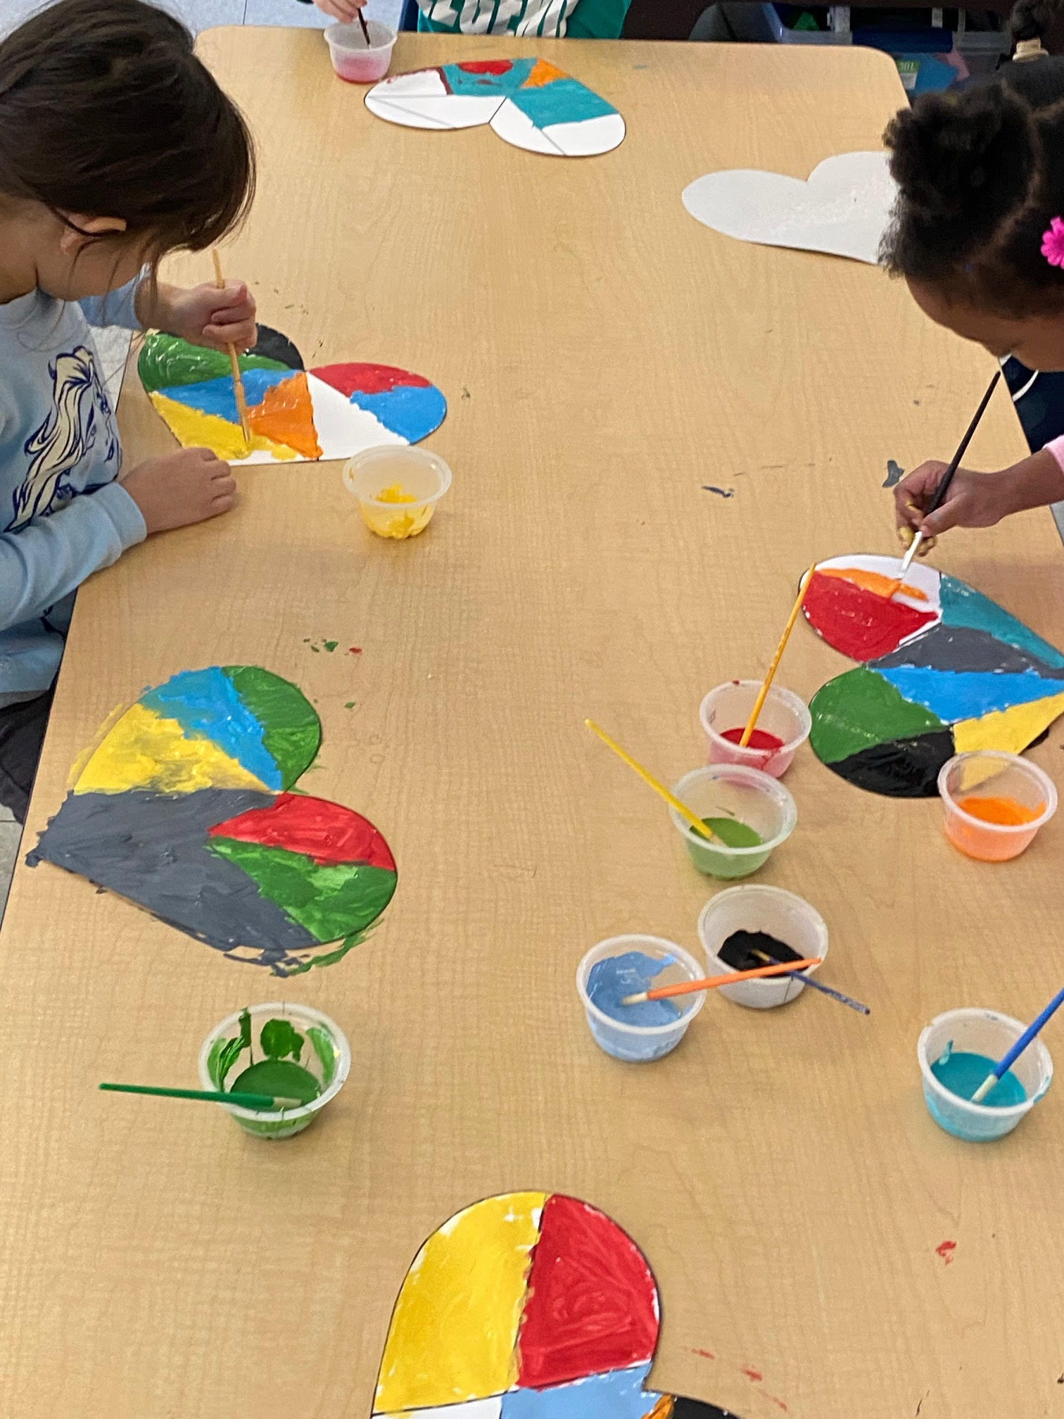
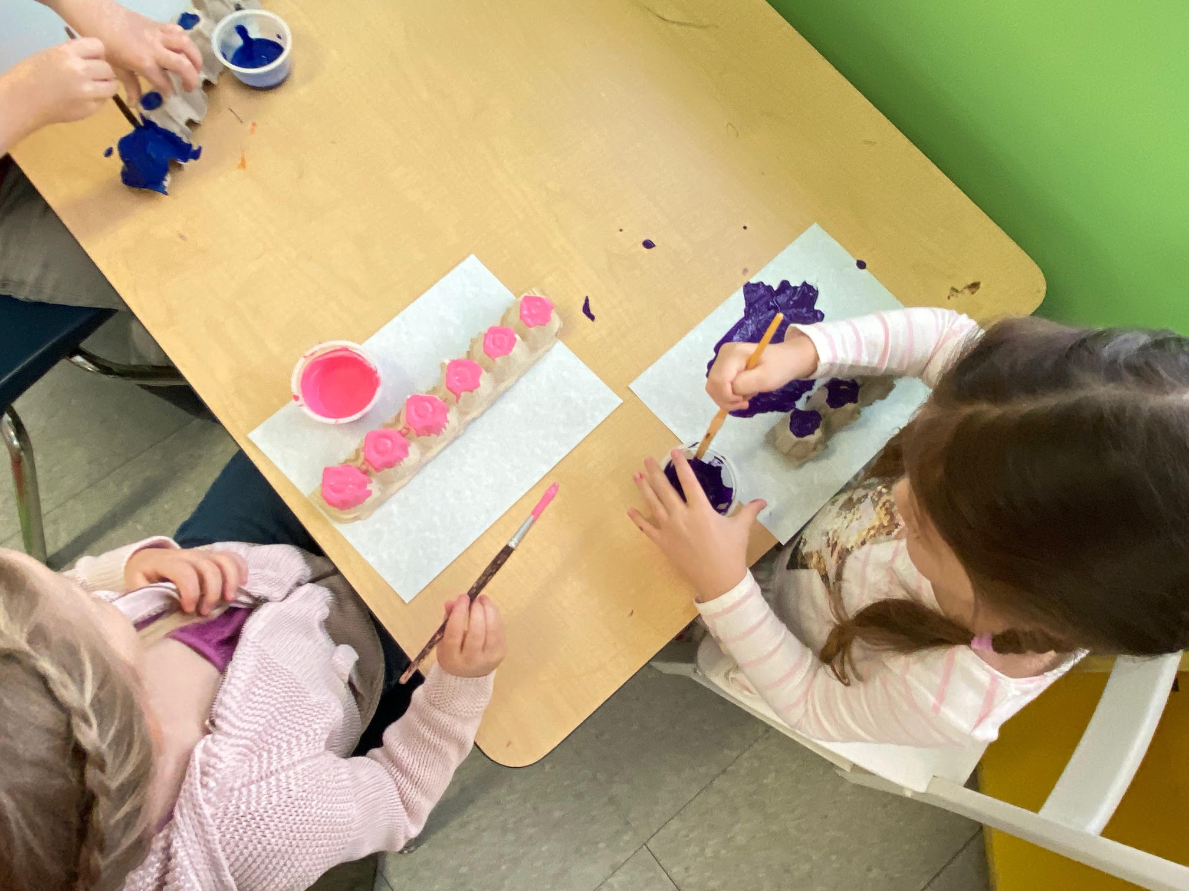
In-class Activities

Slide 9
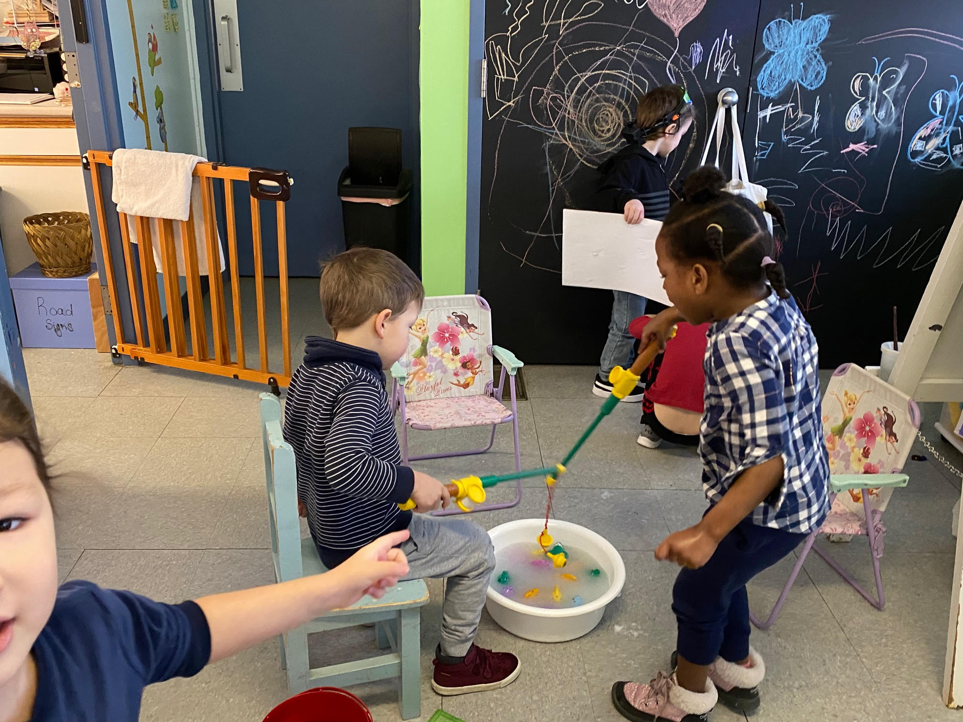
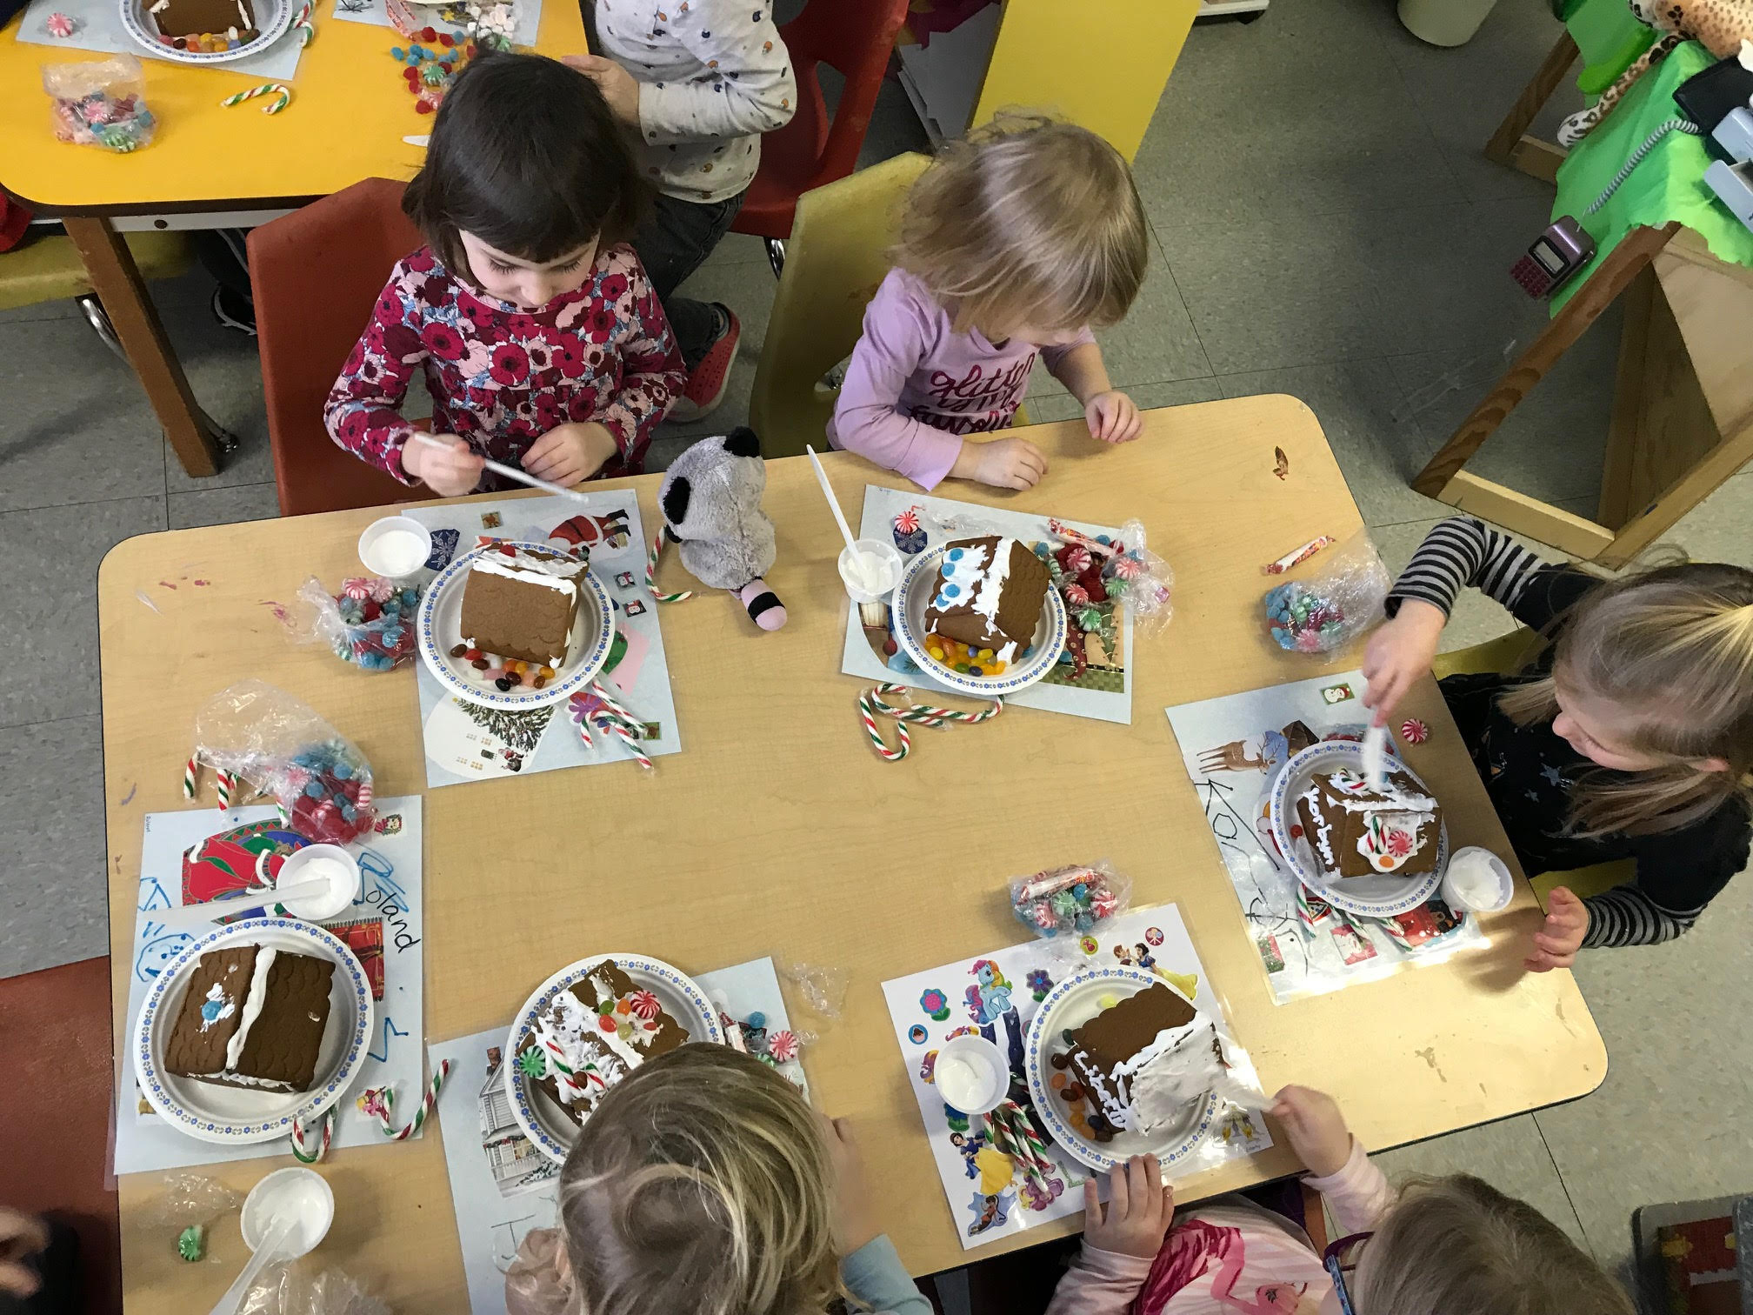
In-class Activities

Slide 10
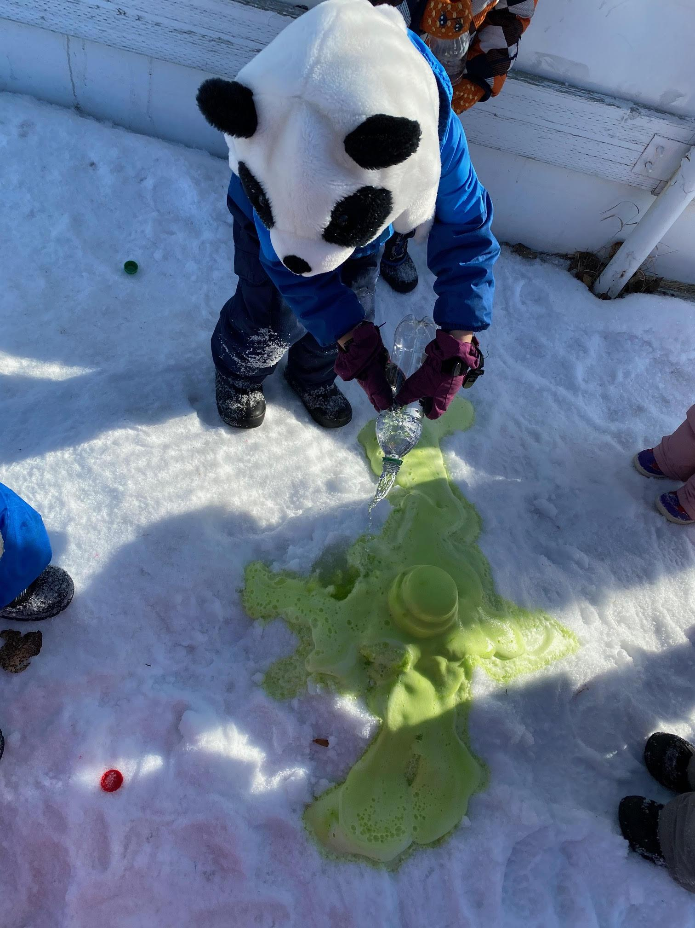
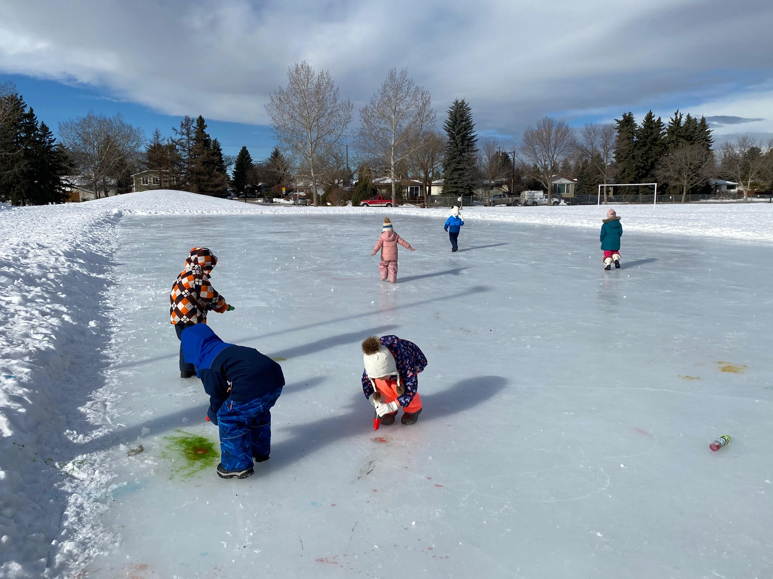
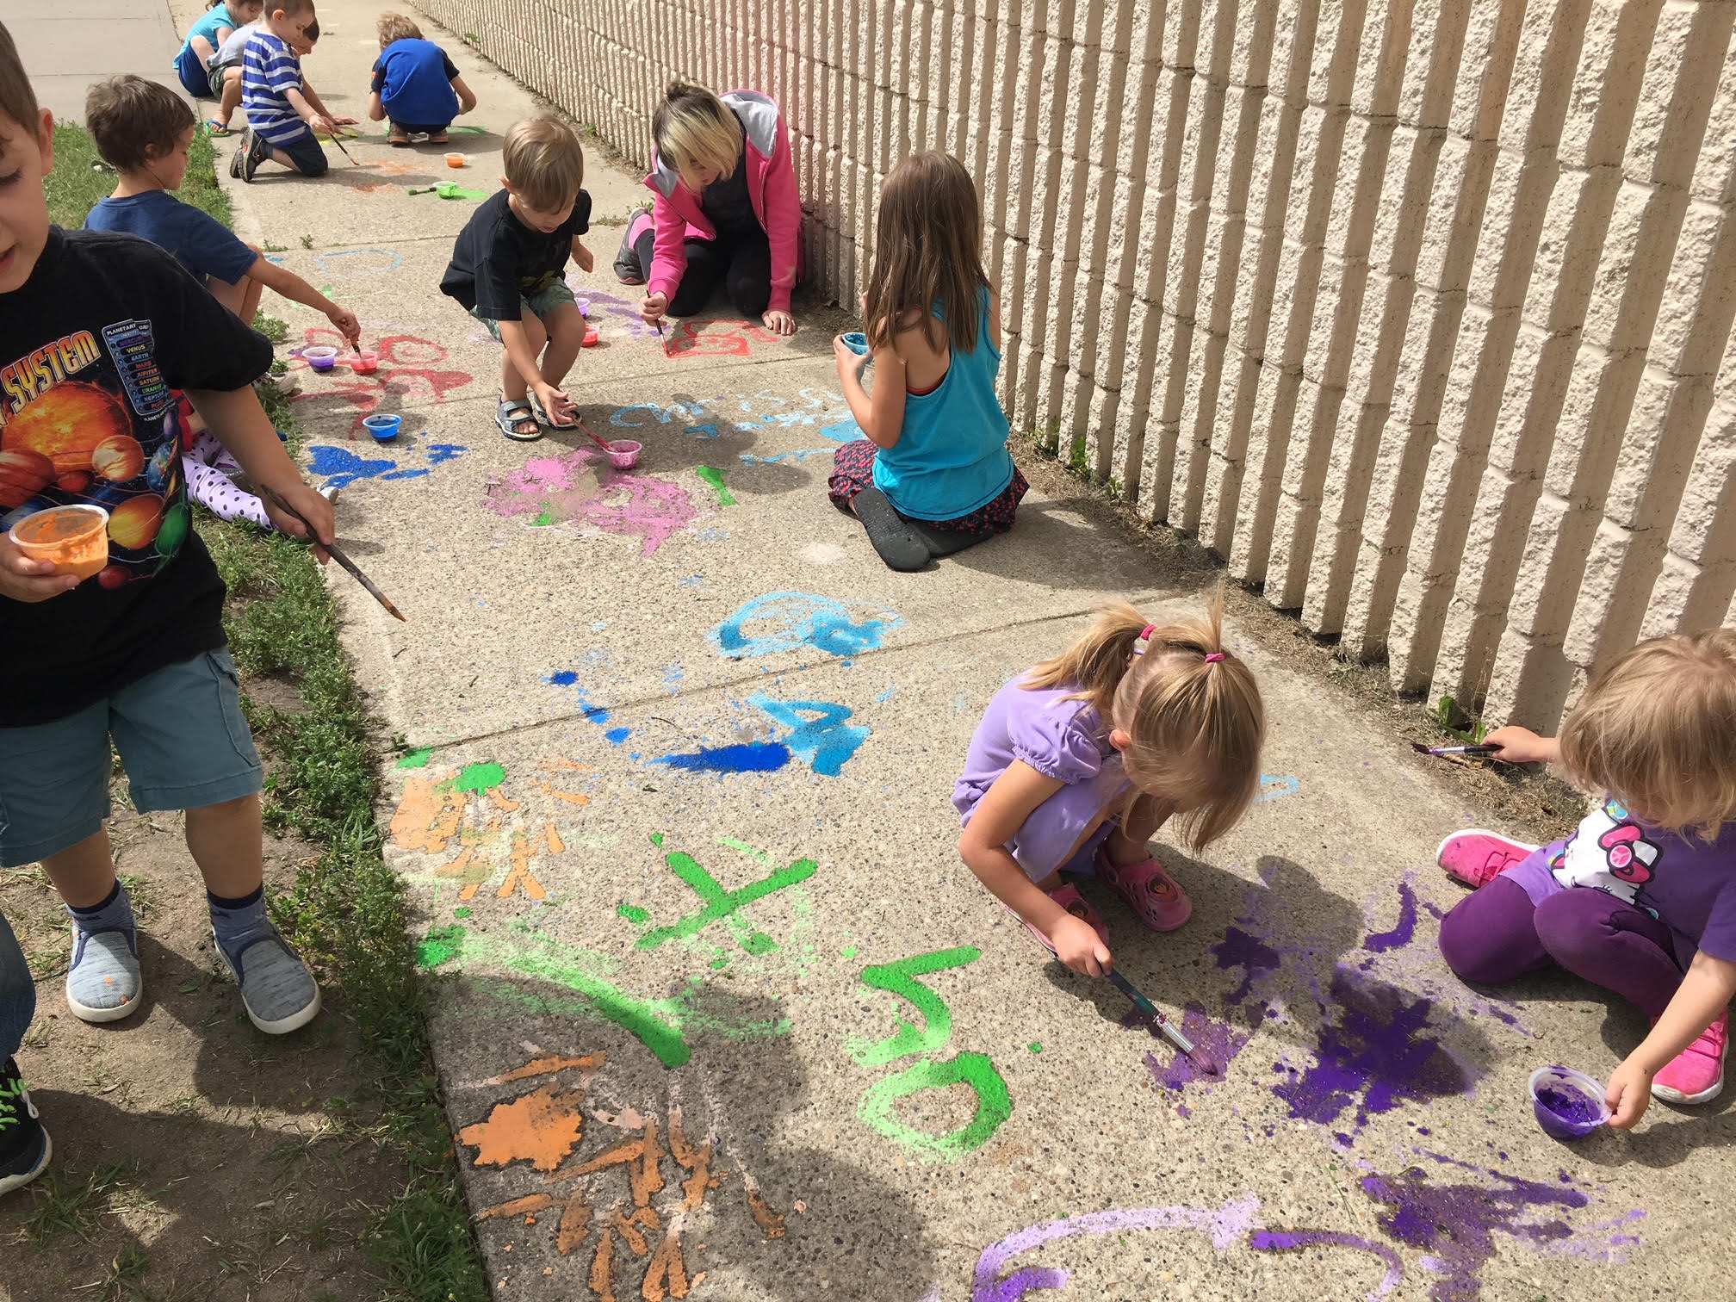
Outdoor Activities

Slide 11
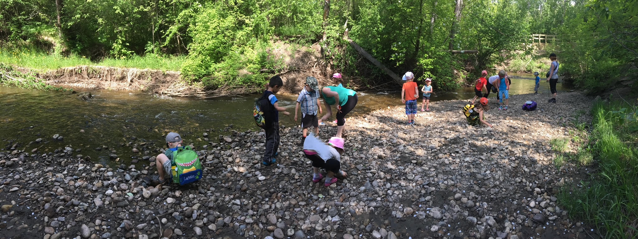
Outdoor Activities

Slide 12
Class Rules
Explain the behavior you expect in your classroom.
Your class rules might include:
Be respectful.
Be responsible.
Follow directions.
Be punctual.
Be organized.
Be a self-starter.
Be prepared.

Slide 13
Policy - General
The Avonmore Community League subsidizes our playschool. It pays for the insurance for the children and enables us to obtain a classroom with no rental fees. Naturally, we are given conditions to continue being subsidized.
Each child must be a Community League member (not necessarily Avonmore) within the Confederation of Community Leagues.
Your child must be at least 3 years of age by December 31st.
Children are asked to be toilet trained, but if need be pull ups are allowed.
Should you choose to withdraw your child from the play school, a written notice must be dated and given one month in advance to ensure that remaining post dated cheques are returned.
Registration fees will not be refunded.
If you are over 5 minutes late picking up your child after class, you will be charged $5.00, this will only be enforced if it becomes an issue.
Playschool will be cancelled in the event of the teacher’s absence when a qualified substitute is not available.
Avonmore Community Playschool reserves the right to refuse a child’s
admittance into the classroom when fees are not paid in full and up to date.

Slide 14
Policy - Discipline
For minor occurrences in the classroom, the teachers will use positive forms of discipline such as distraction, natural and logical consequences and positive reinforcement. For more serious occurrences, children will be guided to more appropriate behavior by an explanation of the reasons for which being destructive, disruptive or dangerous behavior cannot be permitted. A child who persists in being disruptive will be asked to leave the group and may return whenever he/she is willing to stop the disruption. If a child will not stop a tantrum, being destructive or hurting another child, he/she will be stopped by holding his/her hands and being told firmly to stop. The child will sit with the teacher or teacher’s aid and talk about why he/she is there. Once the child clams down, he/she may rejoin the group. If there are any concerns regarding a child’s behavior, the teachers will discuss this with the parents.

Slide 15
Policy - Emergency Medical Attention
Any medical assistance necessary for a child left in the care of the playschool will be sought at the University of Alberta Hospital and be taken by ambulance.
Teachers cannot administer medications, unless it is an epi pen. Parents or emergency contact person will be phoned immediately in the event that emergency medical attention is required.

Slide 16
Policy - Parent Responsibilities
Children must be accompanied to and from playschool by an adult and when dropping off make sure the child has entered the classroom before leaving. Please inform the teachers if your child will be picked up by a relative or other caregiver.
Parents are responsible for undressing and dressing their children in their outerwear each day upon arrival and dismissal time.
Parents are required to provide a nutritious snack each day including two or more food items and a drink if your child wishes not to drink water. Please label your child’s snack bag and water bottle. RESTRICTED FOODS WILL BE POSTED AT THE BOARD BY THE WASHROOMS
If your child would like to celebrate his/her birthday in the classroom, please let the teachers know ahead of time. You may bring in a treat to share with the class and even join us for the morning if you wish.
The play school must be advised of any allergies. If emergency treatment needs to be administered for allergic reactions, such treatment must be taught to the teacher and necessary medicine must be provided (i.e. Epi-pen).
The playschool must be notified of any change of address and/or phone number.

Slide 17
Policy - Parent Responsibilities
6. If your child just has a “sniffle” he/she should join us. However, please keep your child at home with the following symptoms: a cold with congestion, listlessness, fever, rash, diarrhea, vomiting, headache or red runny eyes. If your child contracts a communicable disease (e.g. measles, mumps, strep-throat, chicken pox etc.) please inform the teachers.
7. Washable clothes are preferred, as some of the activities tend to get messy. Please send an extra change of clothing.
8. Remember to take home your child’s precious crafts and creations daily
9. in case of separation, divorce or unsettled situations, the person who has custody of the child must advise the teachers if there is difficulty expected regarding an unlawful party picking up the child. In such cases, the parent must give the teachers the name of the party not allowed to pick up the child. It also must be recorded on the registration form.
10. A play school meeting is held in the classroom during late summer to go over any information needed, before the start of classes in September.
11. If your child will be absent from class, please notify the teachers that he/she will not be attending. You may leave a TEXT on the teachers cell phone 780- 222-7275.

Slide 18
Get Involved
As the school year unfolds there will be many opportunities for parents to get involved with their child’s learning.

Slide 19
REGISTRATION FEES AND PAYMENT SCHEDULE POLICIES
Please make all cheques payable to the Avonmore Community Playschool.
Regular School fees are $120.00/month for 2 days, $145.00/month for 3 days a week, $170.00/month for 4 days a week and $190.00 for 5 days a week. There are 3 ways make payment: 10 post-dated monthly cheques, 2 post-dated cheques (one for each term, September/February) or one lump sum fee at the beginning of the school year.
To avoid problems associated with lack of participation in mandatory volunteering, the playschool requires a Volunteering deposit of $200. This will only be cashed in the event that you are unable to fulfill your volunteering duties throughout the year.
The registration fee is $100.00 and is to accompany the completed registration form to hold the child’s spot in the program.
To comply with licensing regulations, toy cleanings will be scheduled every 4 weeks during regular playschool days (approx. 1 day a month) and parents will no longer be required to do them or put down a deposit, Yay!
All parents are required to have Community League Membership. If you are outside the Avonmore Community, another community league membership is acceptable. Memberships will be available at the first parent meeting for $25.00 per family.
There may be bus fees when we take a yellow bus on field trips (usually two a year) as this is not covered by the pLayschool. Our other field trips we use ETS and are free.
During the year you will periodically see our giving tree grow leaves. If you can help out with an item or 2 off the tree it makes a big difference in helping us provide the children with a few extra fun activities during the year.

Slide 20
Questions?
Contact
Jamie Conrad at playschool@avonmore.org

